Slide 1

R PACKAGE PRESENTATION
INTERNATIONAL FOOTBALL RESULTS ANALYSIS
23PD09 TV DIPANKAR
23PD24 V PARIKSHIT
23PD35 R SHREE NITHESH

Slide 2
Introduction:
Context in dataset:
This dataset includes 47,599 results of international football matches starting from the very first official match in 1872 up to 2024. The matches range from FIFA World Cup to regular friendly matches.

Slide 3
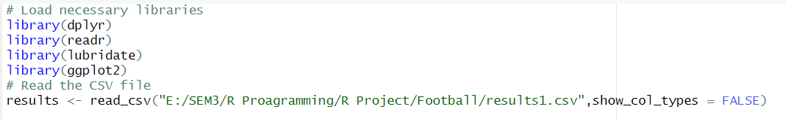
Introduction:
Importing the necessary modules:
the required libraries—dplyr, readr, lubridate, and ggplot2—are loaded. These packages facilitate data manipulation, reading, date handling, and visualization. The CSV file containing football match results is then read into a DataFrame named results.

Slide 4
Introduction:
Dataset description:
The columns are:
date: Date of the match.
home_team: Name of the home team.
away_team: Name of the away team.
home_score: Full-time home team score including extra time, not including penalty-shootouts.
away_score: Full-time away team score including extra time, not including penalty-shootouts.
tournament: Name of the tournament.
city: Name of the city/town/administrative unit where the match was played.
country: Name of the country where the match was played.
neutral: Boolean column indicating whether the match was played at a neutral venue.

Slide 5
Introduction:
Dataset description:
There are 327 unique values in the home_team column and 321 in the away_team column, indicating that not all teams have played at least one match away from home.
A total of 2064 cities have hosted at least one football match. These cities are spread across different countries. The high number of countries (270) has been hosted.

Slide 6
Statistical summary and exploratory visualizations

Slide 7
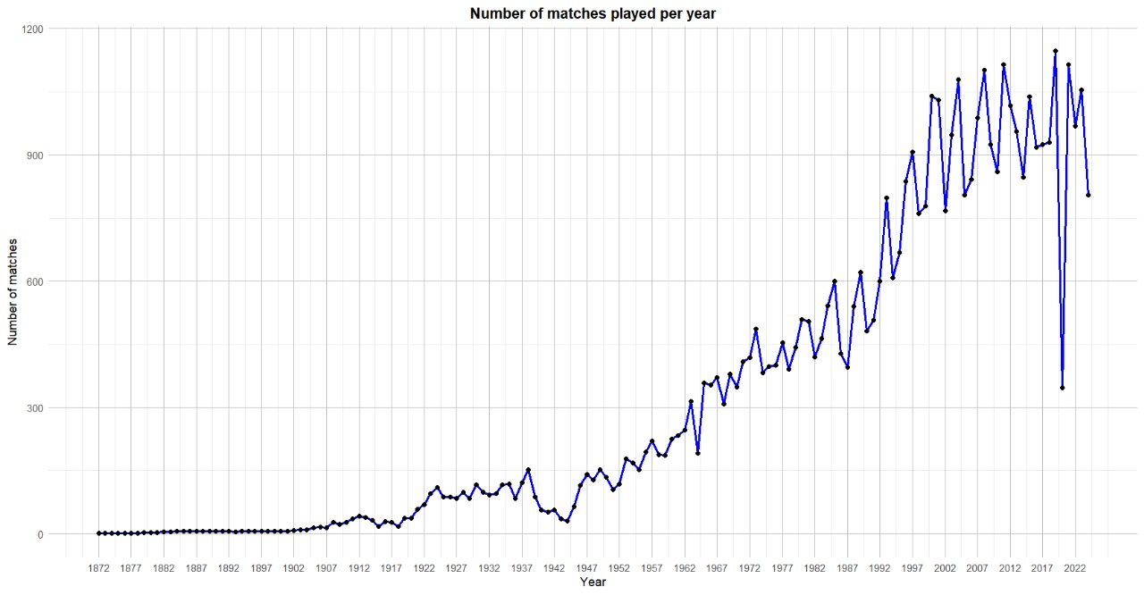
1.Number of matches played per year:

Slide 8
ANSWER
As observed in the graph, the number of matches played has shown an increasing trend over the years:
There was a lower number of matches recorded between 1939 and 1945, coinciding with the period of World War II. The increasing trend did not recover until the 1950s when the FIFA World Cup resumed.
Despite the clear upward trend, approximately every four years, there is a decrease in the number of matches played compared to the previous and following years. These years coincide with the FIFA World Cup, and this is mainly because, during these years, there are fewer qualifying matches, which are usually held in large numbers in other years.
Since around the year 2000, the increasing trend has slowed down and has become more of a consistent alternation.
A significant dip is observed in the year 2020, the year of the pandemic, making it the year with the fewest matches since 50 years before.

Slide 9
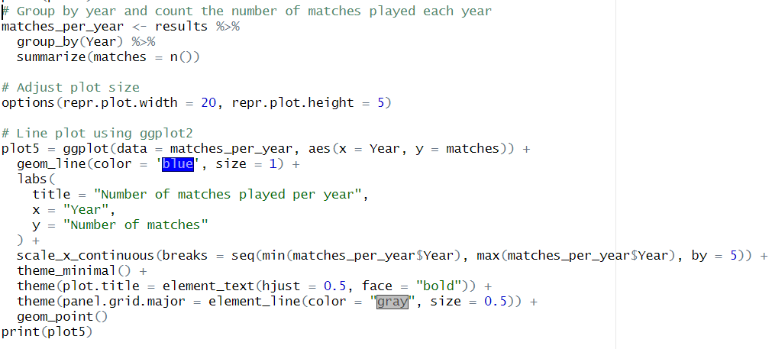
CODE SEGMENT

Slide 10
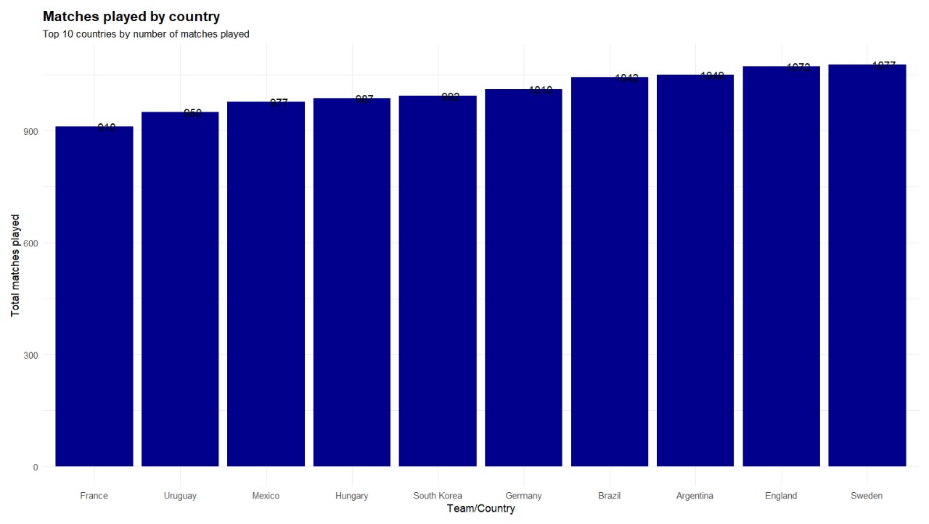
2. Matches played by country:

Slide 11
ANSWER
Teams like Germany, South Korea, Hungary, Mexico, and France are regular participants in World Cups and, as well as the first mentioned teams, are expected to be high on this list.
Given my prior knowledge, it is surprising to me that Sweden is the team that has played the most matches in history.

Slide 12
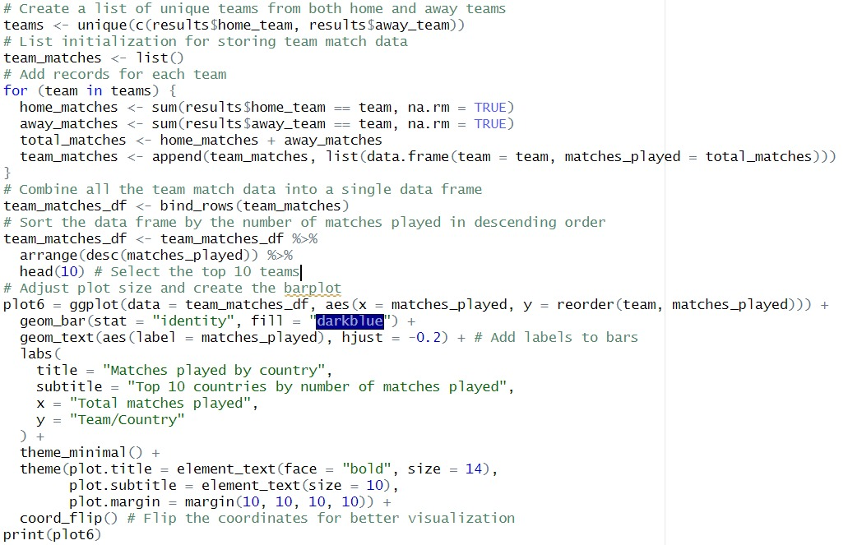
CODE SEGMENT

Slide 13
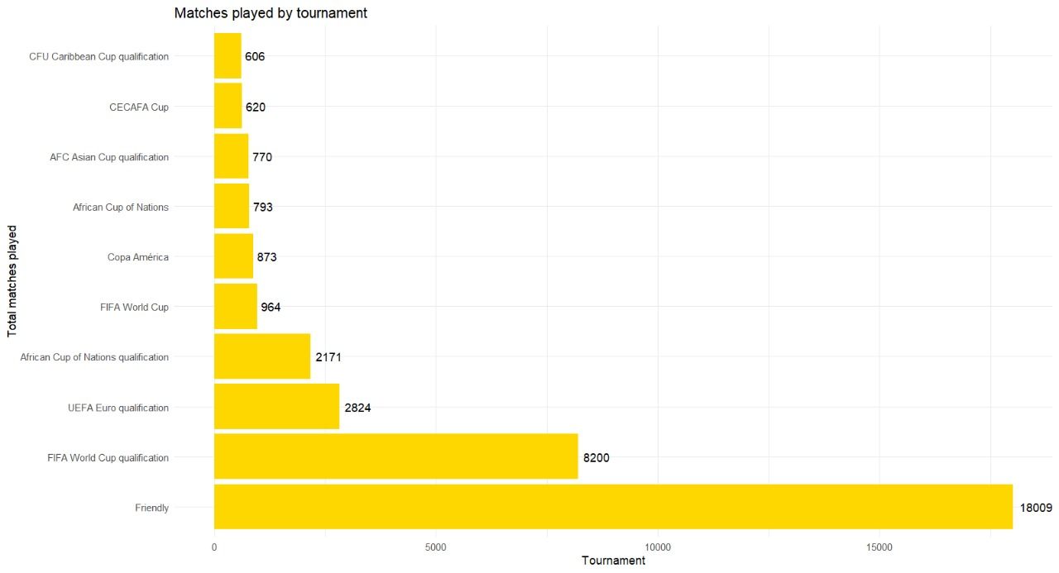
3.Matches played by tournament:

Slide 14
ANSWER
A reasonable hypothesis is that, among official tournaments, the World Cup Qualifiers should have the highest number of matches. It will also confirm that, as seen in the descriptive statistics, the majority of matches in this dataset are friendly matches. It also shows that, after World Cup Qualifiers, the most common matches are qualification games for other major tournaments like the UEFA Euro or the African Cup of Nations.

Slide 15
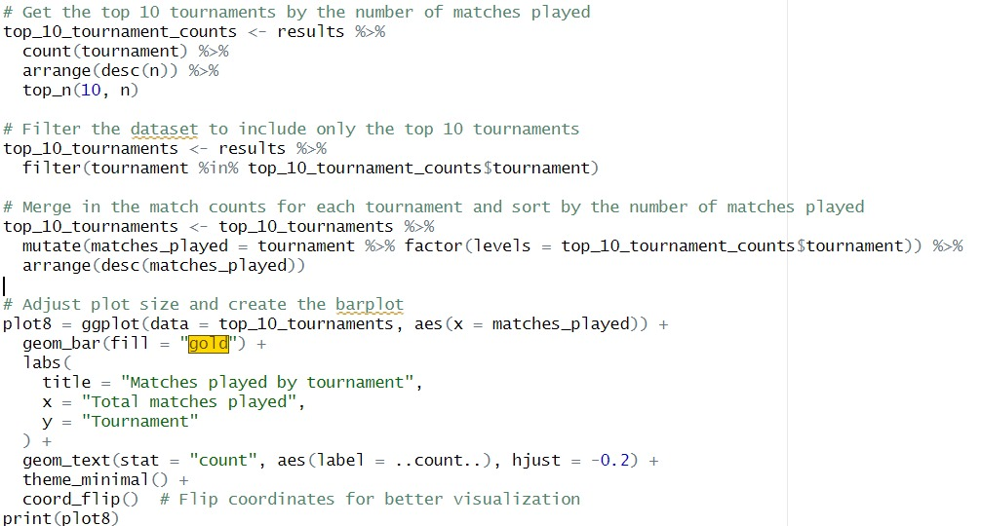
CODE SEGMENT

Slide 16
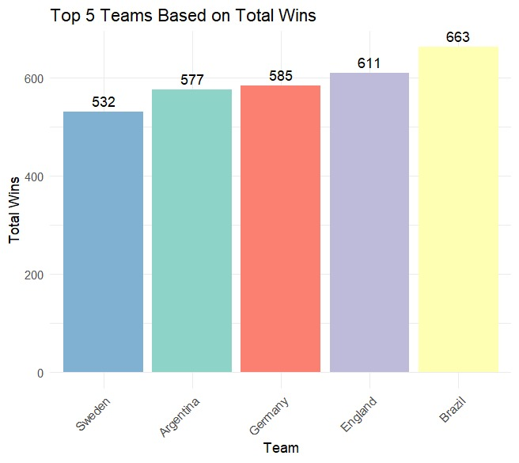
4 .Who is the best team of all time ?

Slide 17
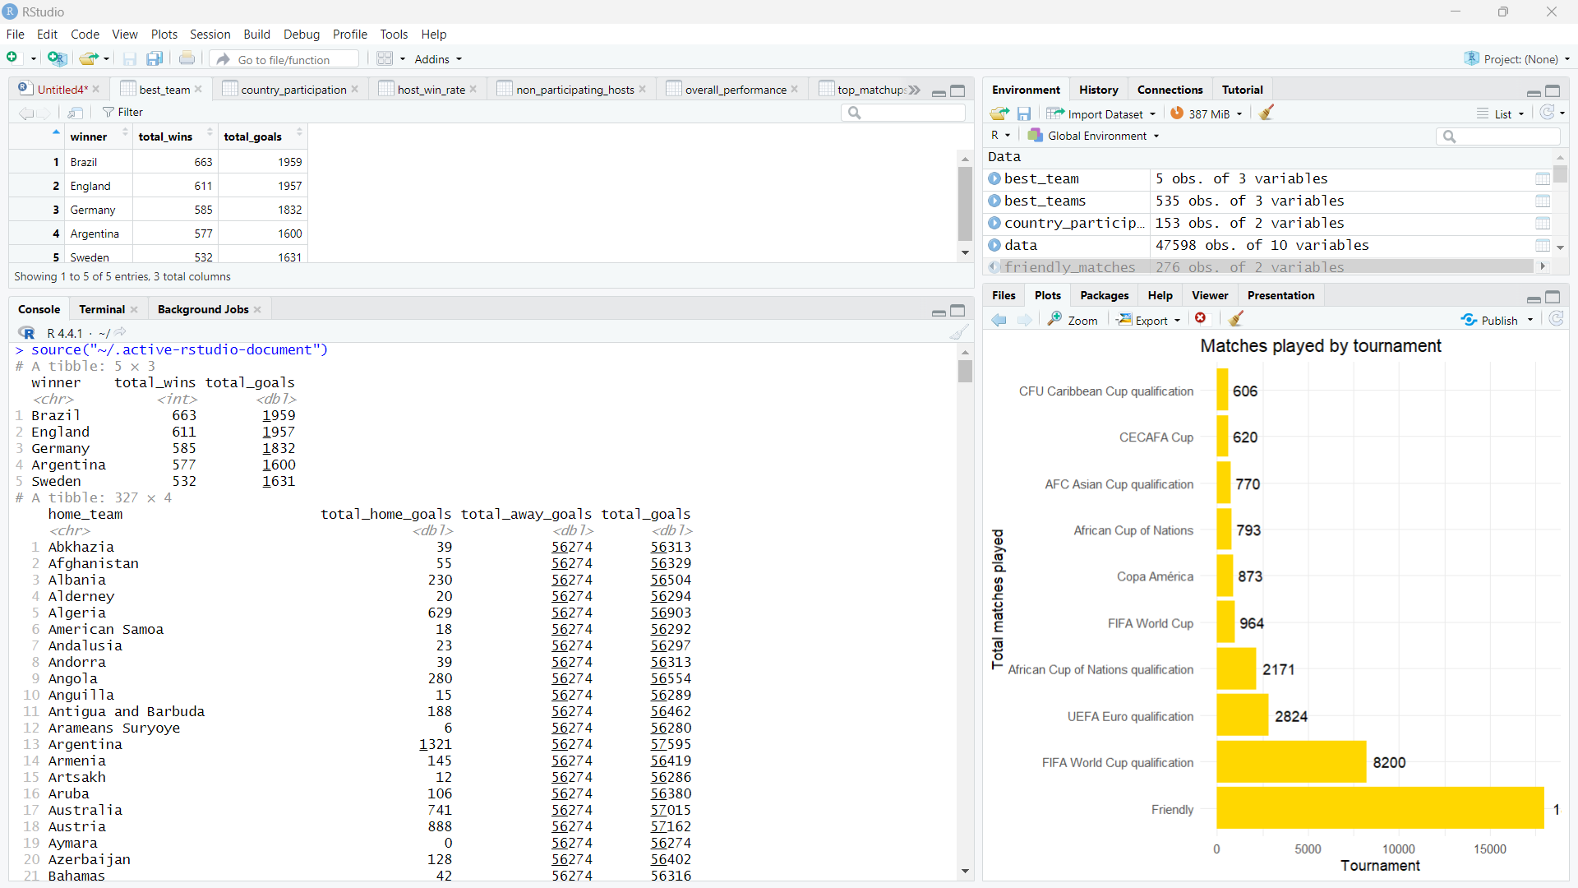
OUTPUT
By comparing the top 5 teams we can say that Brazil has won most number of home matches.

Slide 18
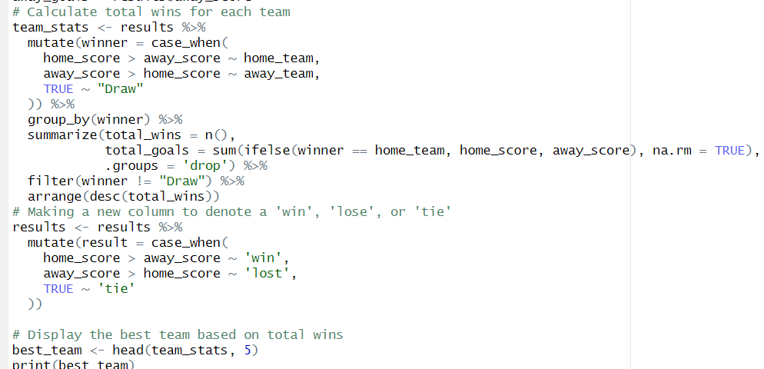
CODE SEGMENT

Slide 19
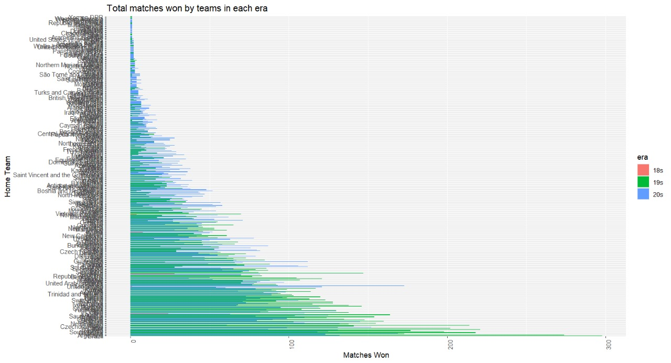
5.which teams dominated different eras of football?

Slide 20
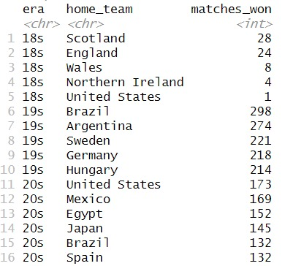

Slide 21
ANSWER
Scotland and England dominated the early era of international football.
The 1900s saw the emergence of Brazil, Argentina, and other European teams like Germany and Sweden as dominant forces.
In the modern era, teams such as the United States, Mexico, and Brazil continued to perform well, while non-European teams like Egypt and Japan gained prominence, reflecting the global growth of football.

Slide 22
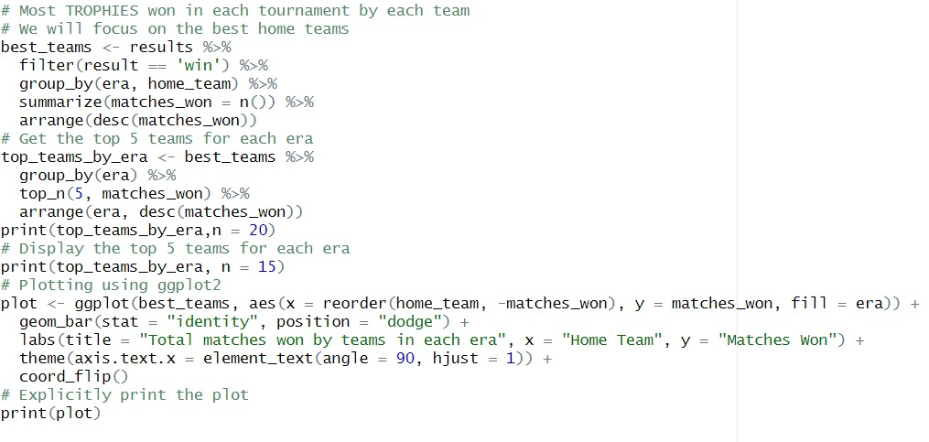
CODE SEGMENT:

Slide 23
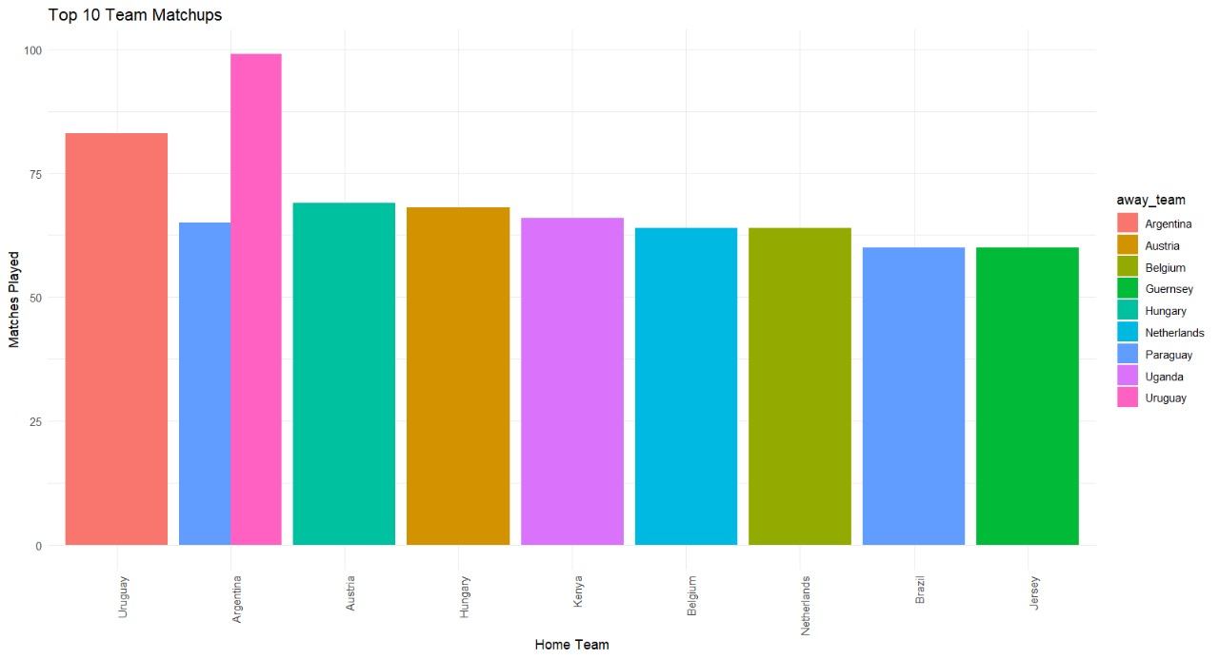
6.Which country play with each other the most:

Slide 24
ANSWER
Argentina and Uruguay have grabbed the 1st spot with 179 total matches together followed by Austria and Hungry with 137 matches together.

Slide 25
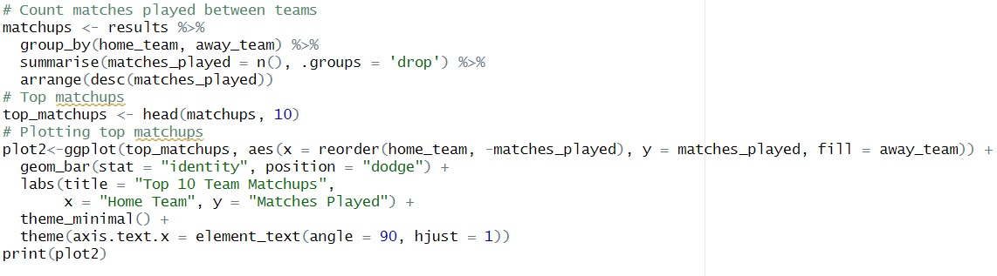
CODE SEGMENT:

Slide 26
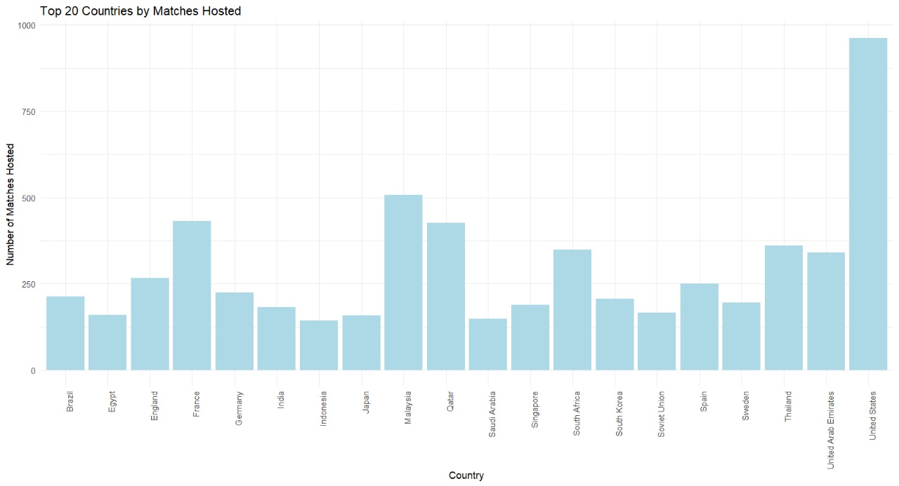
7. Which countries host the most matches where they themselves are not participating in :

Slide 27
ANSWER
United States has hosted 894 matches in which it not participated. It is followed by Malaysia(473 matches) and Quatar(372 matches).

Slide 28
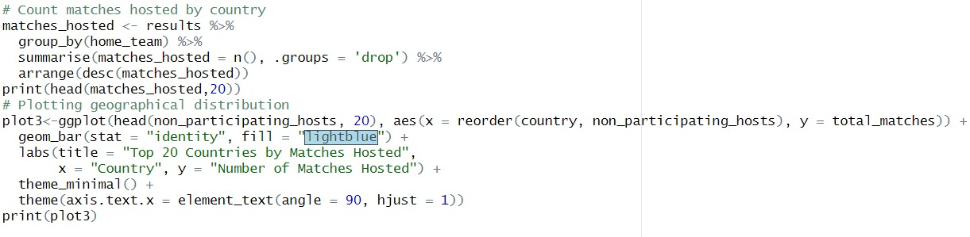
CODE SEGMENT:

Slide 29
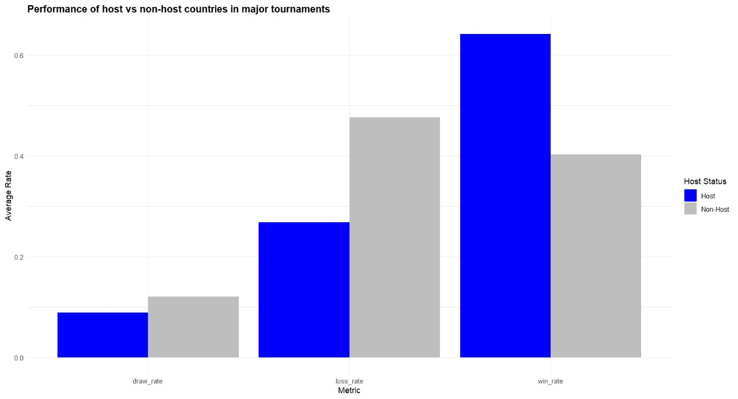
8. Does hosting a major tournament help a country's chances in the tournament?

Slide 30
ANSWER
The bar plot shows that a host country is significantly more likely to win a match, while a non-host is more likely to lose. This indicates a clear average advantage for host countries

Slide 31
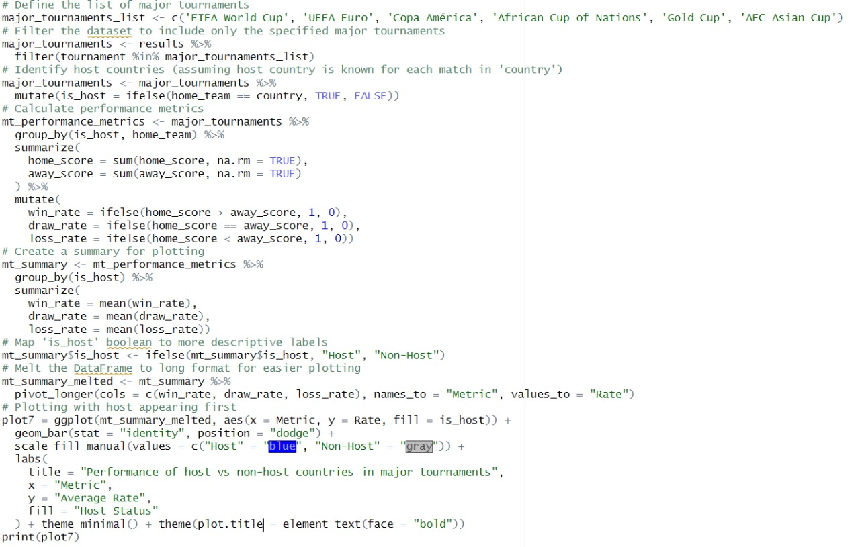
CODE SEGMENT:

Slide 32
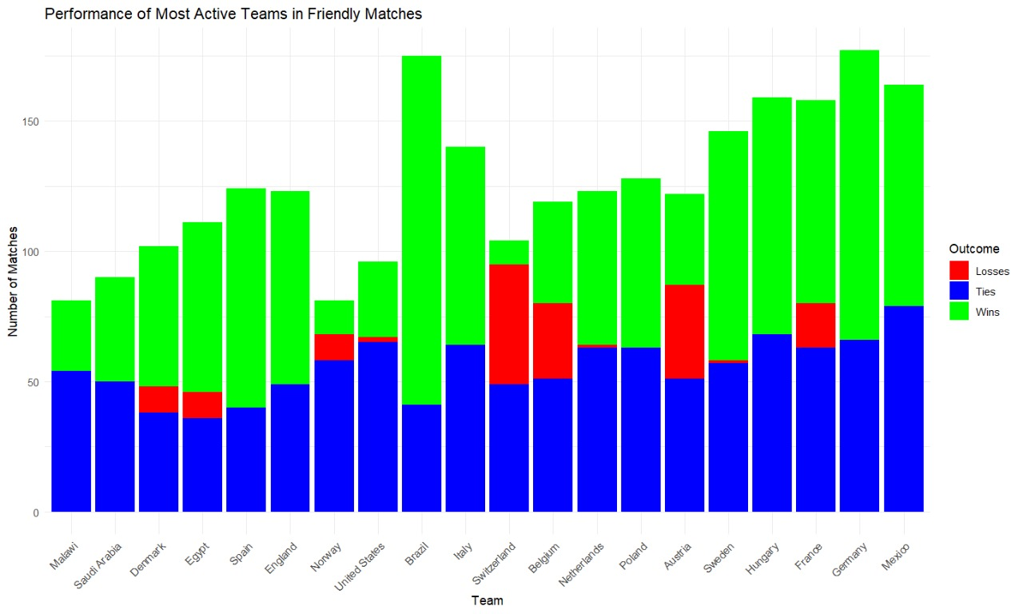
9. Which teams are the most active in playing friendlies and friendly tournaments - does it help or hurt them:

Slide 33
ANSWER
1.High Number of Friendly Matches with High Win Percentages:
Teams like Brazil, Spain, and Italy show a high number of friendly matches and win percentages above 59%. This indicates that they perform well in friendlies, suggesting that frequent participation may help them stay competitive and fine-tune their strategies.
Brazil, in particular, stands out with a very high win percentage (75.8%) and low loss percentage (6.49%). This shows that playing many friendly matches seems to benefit them, allowing them to build momentum and maintain a strong form.
2.High Number of Friendly Matches with Moderate Win Percentages:
Teams like Mexico, France, and Sweden have win percentages around 50-56%. This indicates that while they frequently participate in friendly matches, their performance is balanced between wins and losses. For these teams, friendlies may not significantly harm or benefit their competitive form but still provide valuable practice.
High Loss Percentages Despite Frequent Friendlies:
Teams such as Austria, Switzerland, and Belgium have relatively higher loss percentages (over 30%). This suggests that, despite playing many friendlies, they tend to struggle more often. It could indicate that these teams might not be using the friendlies as effectively for preparation or that they face stronger opponents in these matches.
Correlation Between Win Percentages and Tournament Success:
The teams with higher win percentages in friendlies (e.g., Brazil, Spain, Italy, England) are generally more successful in major tournaments, suggesting that consistently strong performance in friendlies may be an indicator of overall team strength and preparedness.
Conversely, teams with lower win percentages may not use friendlies as effectively for preparation, or they may schedule friendlies against stronger opponents, leading to more losses.
Conclusion:
The data suggests that teams actively participating in friendlies can benefit from the practice if they manage to maintain a higher win percentage, as seen with Brazil, Italy, and Spain. However, for teams with higher loss rates, frequent friendlies might not provide the same benefit, potentially highlighting areas that need improvement. Thus, playing friendlies can help teams sharpen their skills and strategies, but the impact varies depending on how well they perform in these matches.

Slide 34
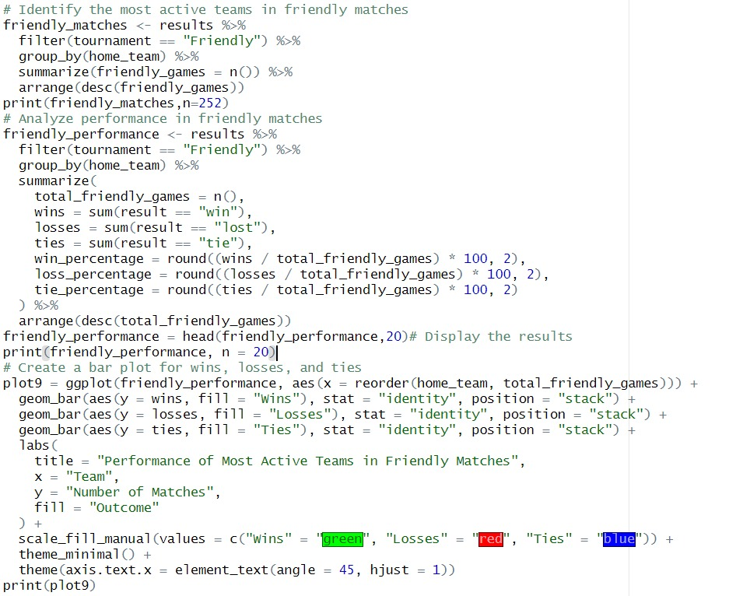
CODE SEGMENT:

Slide 35
Conclusion:
We observed an overall increase in matches played over the years, with notable dips during historical events like World War II and the COVID-19 pandemic. Teams such as Brazil have consistently demonstrated strong performance, particularly in friendly matches, suggesting a correlation between frequent play and competitive success. Additionally, the advantage of host countries in major tournaments underscores the importance of home-ground support. These insights not only enrich our understanding of football's evolution but also provide a foundation for future research into strategies for improving team performance on the global stage.

